Slide 1
Propagation of Misleading News
about Donald Trump
May 2017
Beatrice Garcia

Slide 2
Research Question/Hypothesis
What is the propagation rate of misleading news about Donald Trump on Twitter?
How susceptible are its audiences?

Slide 3
Background
Definition of “misleading news”
  any news article, social media posting, or website post that could be verifiably false, but also uses persuading language

Slide 4
Existing Work
“How Fake News Goes Viral: A Case Study” by Sapna Maheshwari from the New York Times
“This Analysis Shows how Viral Fake Election News Stories Outperformed Real News on Facebook” by Craig Silverman from Buzzfeed News analysis
“Social Media and Fake News in the 2016 Election” by Hunt Allcott and Matthew Gentzkow from Stanford University

Slide 5
Data Collection
Resources:
  Twitter
  Python
  ArangoDB
Set up ArangoDB, Twitter stream and collected about 100,000 tweets.
Found the top 25 most tweeted URLs and find the top 10 fake news articles.
Opened the stream for about 4 days to collect tweets with chosen posts by tracking URL.

Slide 6
Analyses
Time Series – shows how viral a post got over the four-day span
Bar Chart comparing number of RTs each URL got + Time Series – provide some explanation about how a post went viral
Sentiment Analysis – provide summary of audience susceptibility

Slide 7
Results
Tracked Posts include several spam-type websites such as viralfactamazing.com and biased or unaccredited news sources
  Jezebel
  HuffingtonPost

Slide 8
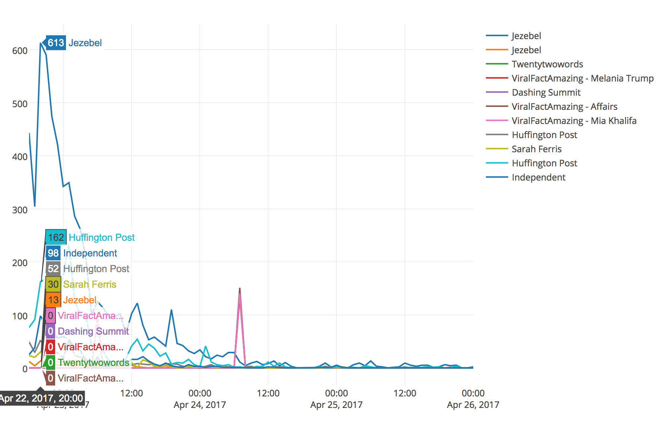
Results
Most Viral Tweet: Caitlyn Jenner’s refusal to golf with Trump from the Jezebel

Slide 9
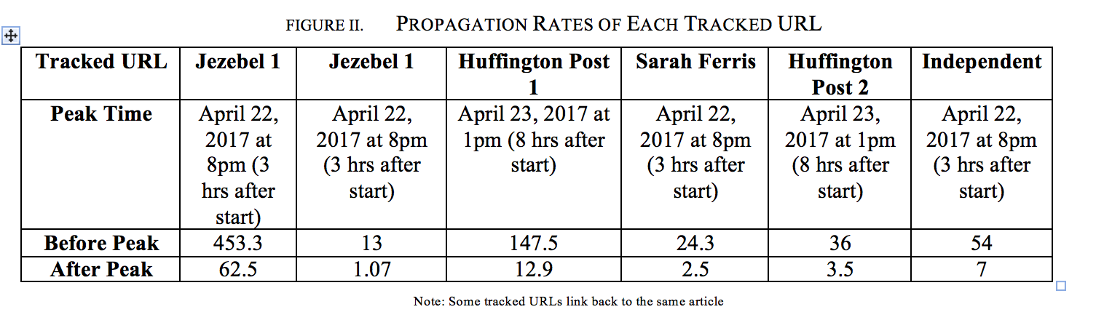
Results
Propagation Rate = Ave. # of Tweets with URL/Hour
Measure rates before and after peak
Excluded Caitlyn Jenner since it was more of an outlier
Average: 54.96 tweets per hour

Slide 10
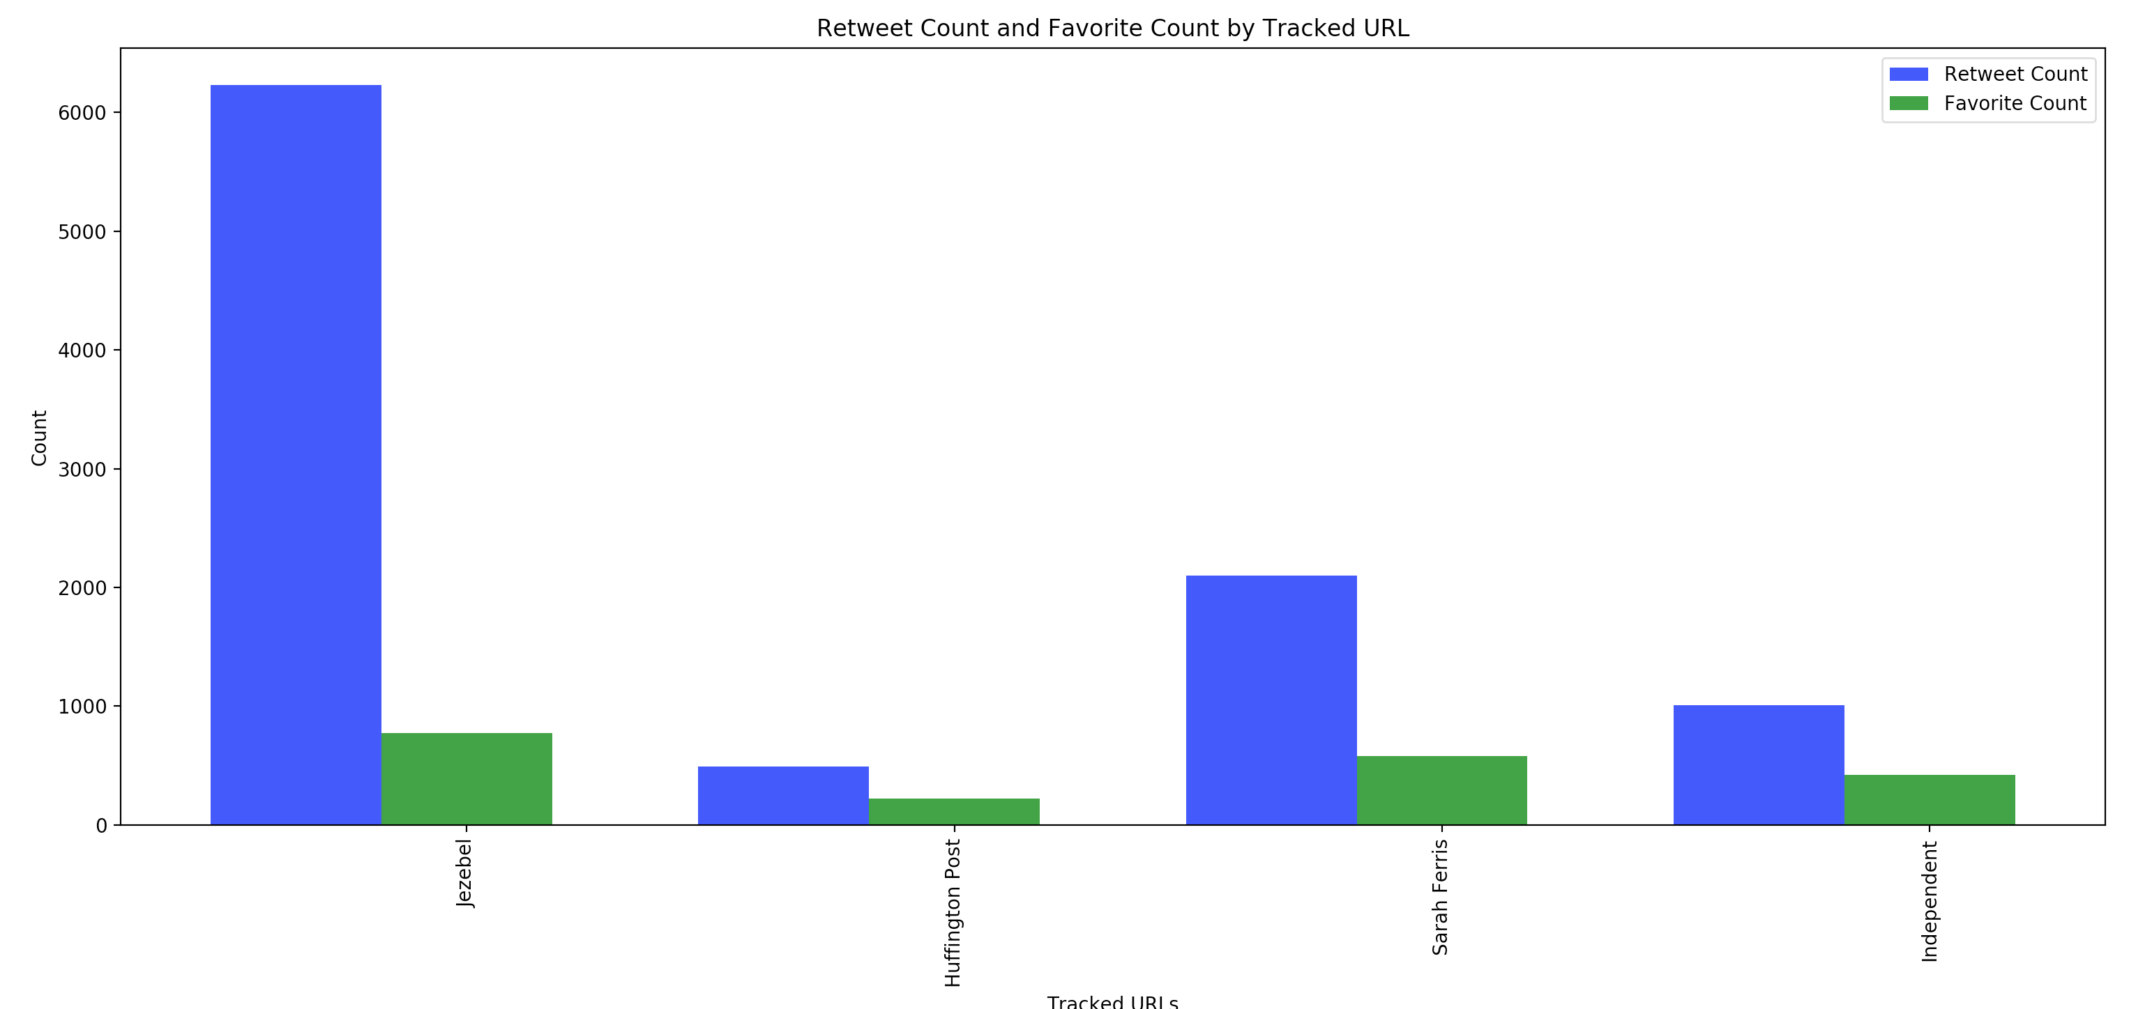
Results
Correlation between virality and number of tweets

Slide 11
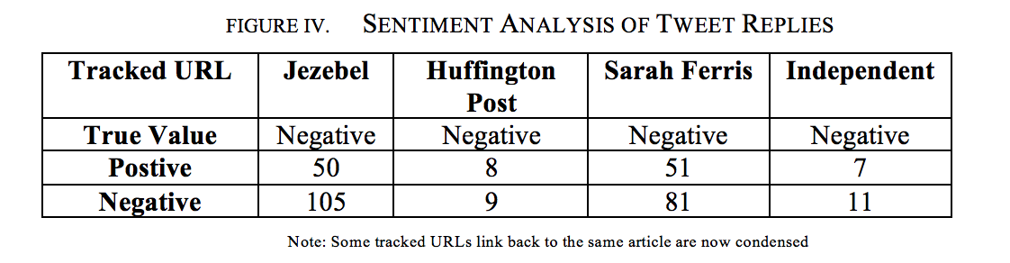
Results
Sentiment Analysis on replies to tweet to determine audience susceptibility
Much of the replies were sarcasm

Slide 12
Conclusions
The Kardashians have won again
Sentiment analysis suggests that audiences do believe in the content
  A lot of extreme perspectives in the replies
News sources tweeting articles and users Retweeting articles suggest that users regularly use Twitter as their news source
Virality peaks after only a few hours

Slide 13
Limitations
Did not track virality of real news to compare
No access to big data Twitter APIs
  Hit rate limit a couple times
Bots were not filtered out – cause of spam-type websites to be in the top 10
NLP Limitations such as inability to classify sarcasm, images or emojis, or “Twitter” language

Slide 14
Future Work
Take care of the limitations
Track viral articles on other social media platforms along with Twitter

